Slide 1

SPA Appointment Booking System
By:
Saroj Baral, Nikhil Thapa Prashant Sapkota R.A Mon

Slide 2

Introduction
Digitalized application to manage appointments.
Why was this idea proposed?
Feasibility of the SPA Appointment Booking System.
What kind of application is it?
Where does this system mainly focus on?

Slide 3
Problem Statements:
MICRO LEVEL
MACRO LEVEL
Time Consuming
Lack of Convenience
Tension due to manual recording
Lack of tech adaptation
Difficulty in competing in the market

Slide 4
OBJECTIVES
SOLVING ISSUES
Easier Registration
Appointment management
User-friendly
EXTRAS TO MAKE IT A COMPLETE SYSTEM
Security
Edit Price

Slide 5
Methodology
Chosen One:
Incremental Model
Why?
The system becomes easier to develop as requirements are gathered at once and is divided into parts to build an increment and in those increments proper priority is given to every features of the system. There’s proper loop of doing things rather than taking a huge leap.

Slide 6
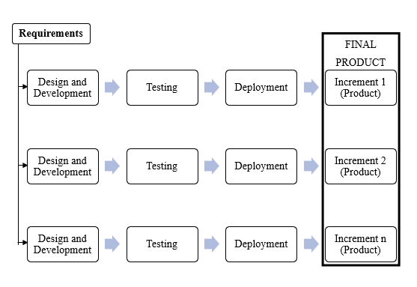
Incremental Model
Fig: Incremental Model

Slide 7




Delivereables:
What is this project trying to achieve?
Constituent parts: Source Code DataBase Authentication System Appointment Management System Testing and Debugging Documentation Deployment

Slide 8

Any Confusions? Let’s clear it out…. Any Question? We’ll Answer it out….

